Slide 1
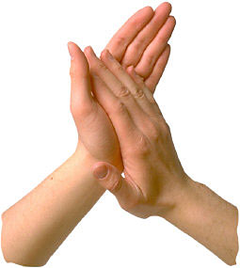
"If You’re Happy and You Know It“
Engelsk børnesang
If you're happy and you know it, clap your hands
(clap clap)
If you're happy and you know it, clap your hands
(clap clap)
If you're happy and you know it, and you really want to show it
If you're happy and you know it, clap your hands.
(clap clap)

Slide 2
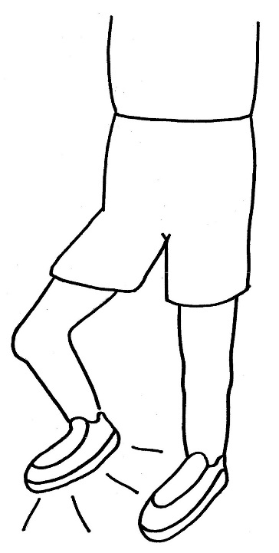
If you're happy and you know it, stomp your feet
(stomp stomp)
If you're happy and you know it, stomp your feet
(stomp stomp)
If you're happy and you know it, and you really want to show it
If you're happy and you know it, stomp your feet
(stomp stomp)

Slide 3
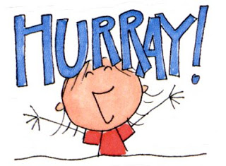
If you're happy and you know it, shout "Hurray!"
(Hurray!)
If you're happy and you know it, shout "Hurray!"
(Hurray!)
If you're happy and you know it, and you really want to show it
If you're happy and you know it, shout "Hurray!"
(Hurray!)

Slide 4
If you're happy and you know it, do all three
(clap-clap, stomp-stomp, Hurray!)
If you're happy and you know it, do all three
(clap-clap, stomp-stomp, Hurray!)
If you're happy and you know it, and you really want to show it
If you're happy and you know it, do all three
(clap-clap, stomp-stomp, Hurray!)

